Slide 1
How to play Galaga 2.0
Anuj Gupta, Indhar Gopalalalalaa, Omar Khan, Joshua Hughes

Slide 2
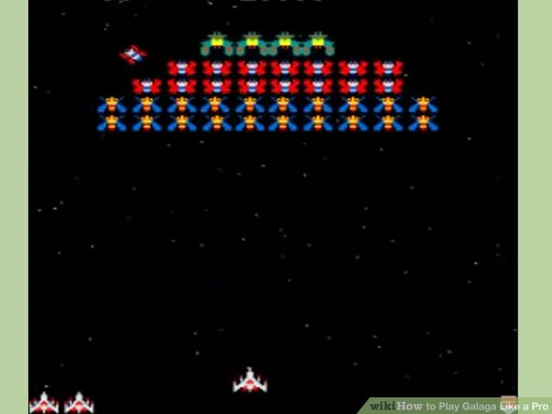
1. Learn how to stop the aliens from shooting at you.
Kill all of the aliens except the two blue aliens on the far left side. They will start out one above the other.
The aliens will cycle through the same motions for 5 to 30 minutes. Watch Out! Occasionally, shots will come from the right side of the screen. Be ready to react
Practice shooting at the aliens, by pressing the start button instead of "Fire". This practice will allow you to get your timing down.

Slide 3
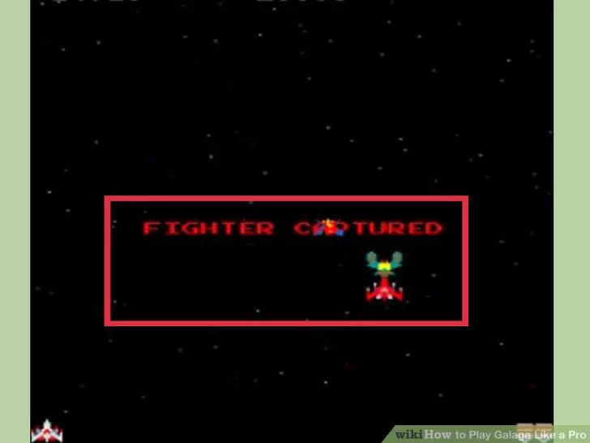
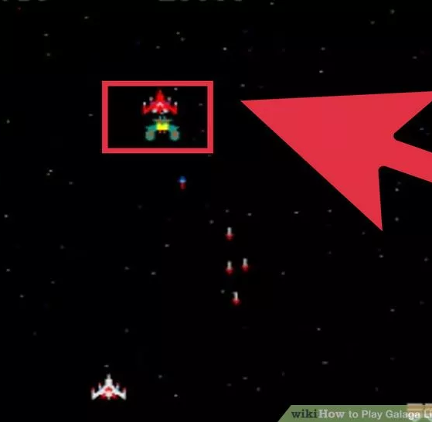
2. Join two ships together
Allow one of your ships to be captured. The rotating scene, when the game is not being played, will demonstrate this.
Shoot the Galaga that has captured your ship as it is making its run toward you.
Do not shoot your ship!

Slide 4
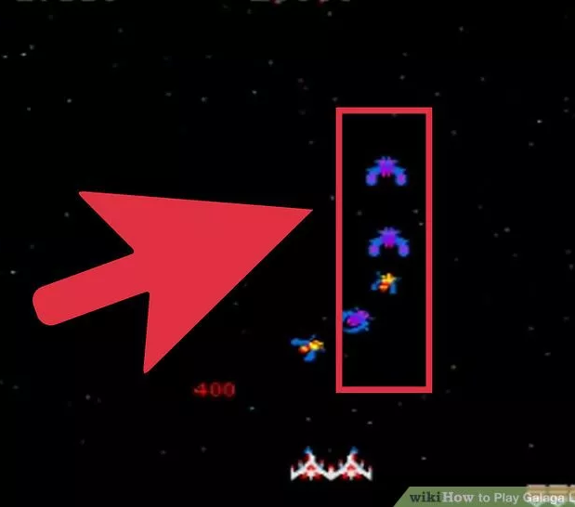
3. Minimize the attack at the beginning of the stage
Attack slightly off center, to the right immediately after the "Stage" message
You want to destroy as many aliens as possible at the beginning of the stage.
Some of the bugs will make diving attacks at you while entering. You will need to move out at the right time

Slide 5
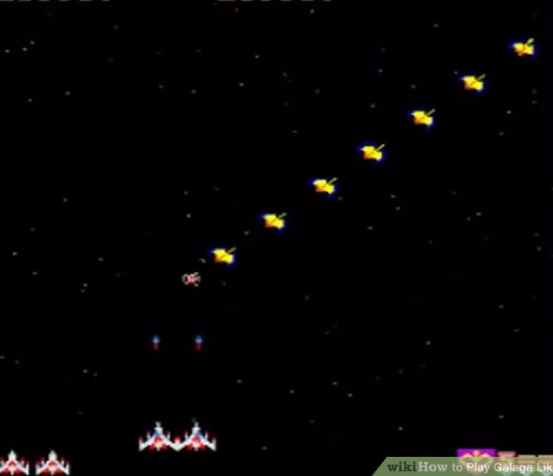
4. Learn the way the aliens enter
The basic entrance pattern on each stage (except challenging stages) goes like this:Double top attack; Red and blue aliens come from the top. Every stage starts with a double top attack.
The attacks below change, depending on the stage. Fortunately, the changes are not random. See the next step.
The first stage after each challenging stage is always (except stage 4) a Double Side attack stage. Otherwise, they will enter as described below.
Galagas and red aliens enter from the bottom left.
Red aliens enter from the bottom right.
Blue aliens enter from the top left.
Blue aliens enter again from the top right.

Slide 6
5. Eliminate as many aliens as possible during the entrance phase!
Maximum scores are awarded during the entrance phase, except bonuses are not given for Galaga escorts..
Later in the game (after the second challenging stage), the aliens will speed up rapidly after going out the bottom of the screen! Handling this is easy, if most of the aliens are gone. It is very difficult when the screen is crowded.
If you have a choice of red aliens or blue aliens to eliminate, choose the red.

